Slide 1
Predictive analysis of stocks - TESLA
Bianca Daniciuc
Tea Gheorghe

Slide 2
Agenda
01
Introduction
02
Analysis
03
Curiosity: Sentiment analysis
04
Conclusion

Slide 3
Introduction
Contents
Contents
You can simply impress your audience and add a unique zing and appeal to your Presentations.
Contents
You can simply impress your audience and add a unique zing and appeal to your Presentations.
Contents
You can simply impress your audience and add a unique zing and appeal to your Presentations.
You can simply impress your audience and add a unique zing and appeal to your Presentations.

Slide 4
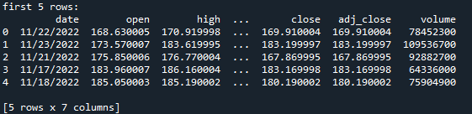
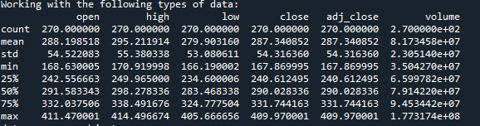

Analysis
The data we had to work with
print(tesla_data.describe())
Data source, one year data

Slide 5
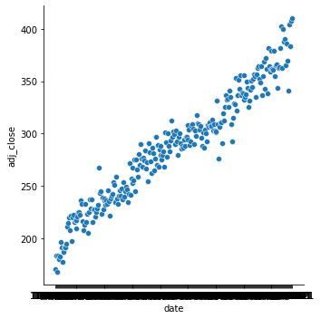
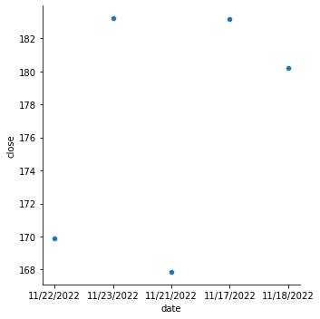
Analysis
Add Skills – 70%
Add Skills – 80%
Add Skills – 60%
Add Skills – 90%
Closing price

Slide 6
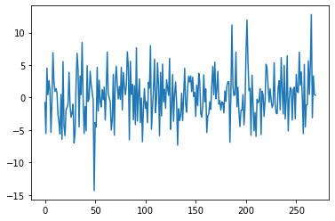
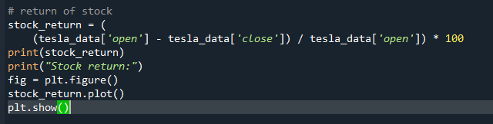
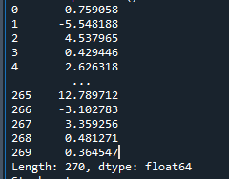
Analysis
Stock return
Add Skills – 70%
Add Skills – 80%
Add Skills – 60%
Add Skills – 90%

Slide 7
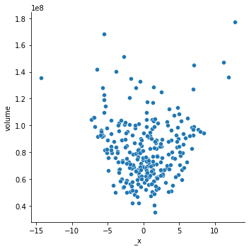
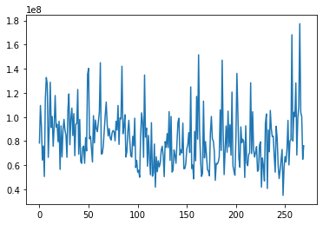
Analysis
Return of stocks per volume
Volume

Slide 8
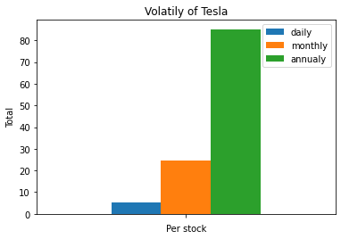
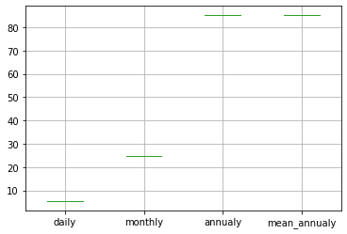
Analysis
Volatility of Tesla’s stocks
Boxplotting the mean of volatility

Slide 9
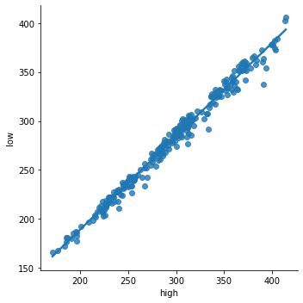
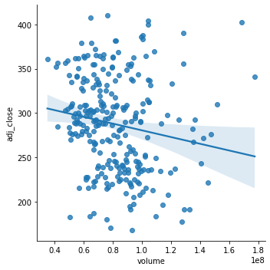
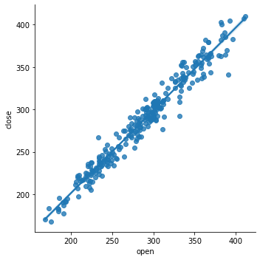
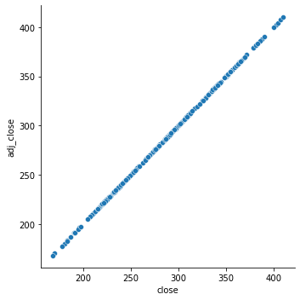
Analysis – linearity of stocks

Slide 10
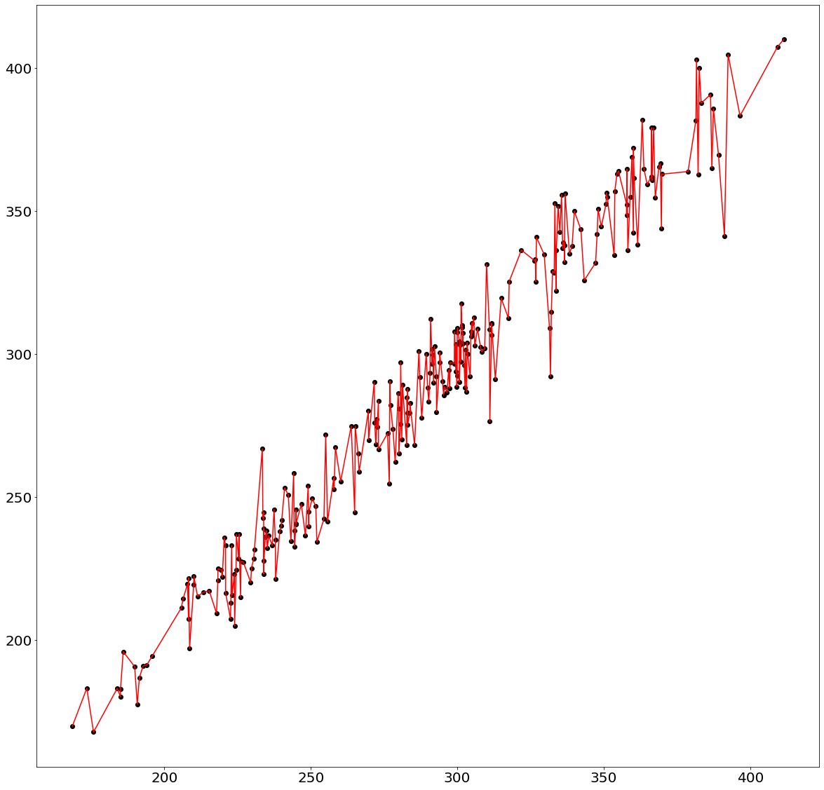
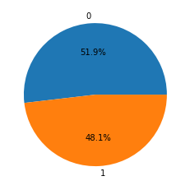
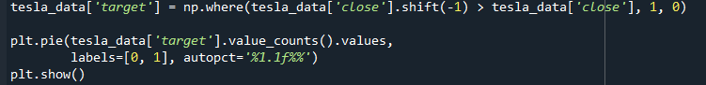
Analysis – linearity of stocks
Linear forecast
Target of TESLA’s stocks

Slide 11
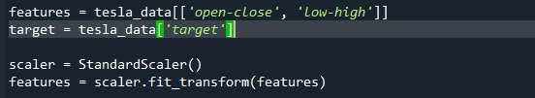
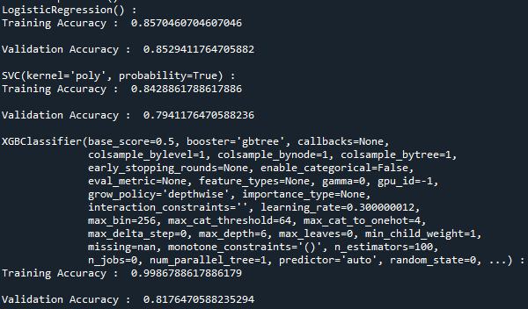
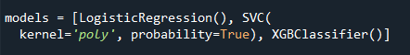
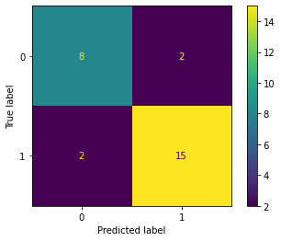
Analysis – Normalization & trainning
Result:
Normalization: StandardScaler
Trainning: Logistic Regression

Slide 12
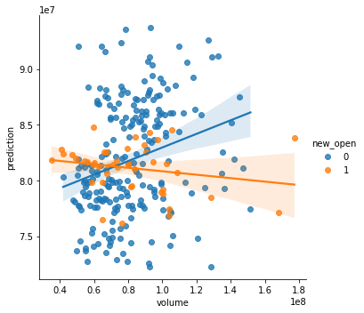
Analysis – prediction of the future price

Slide 13
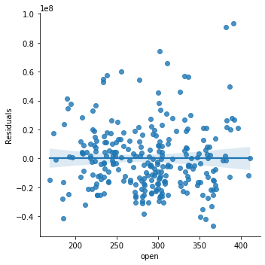
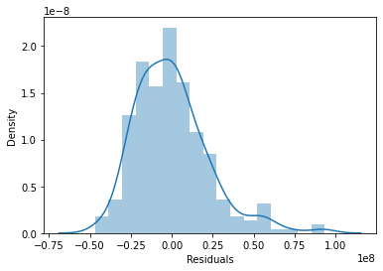
Analysis – Residuals

Slide 14
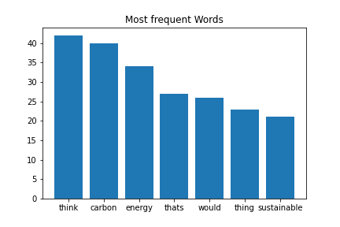
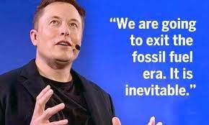
Curiosity: Sentiment analysis
Speech:
Université de Paris Panthéon Sorbonne - Sustainability

Slide 15
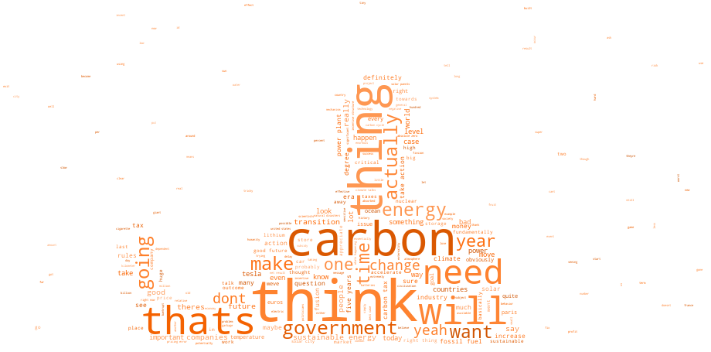
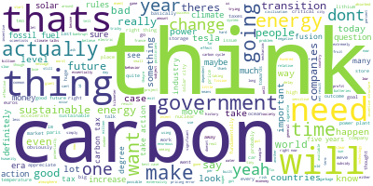
Curiosity: Sentiment analysis
Sentiment
Score:
0.10657329232009413

Slide 16
Conclusion
You can simply impress your audience and add a unique zing.
You can simply impress your audience and add a unique zing.
You can simply impress your audience and add a unique zing and appeal to your Presentations. I hope and I believe that this Template will your Time, Money and Reputation. You can simply impress your audience and add a unique zing and appeal to your Presentations.
You can simply impress your audience and add a unique zing and appeal to your Presentations. I hope and I believe that this Template will your Time, Money and Reputation. You can simply impress your audience and add a unique zing and appeal to your Presentations.
You can simply impress your audience and add a unique zing.
You can simply impress your audience and add a unique zing and appeal to your Presentations. I hope and I believe that this Template will your Time, Money and Reputation. You can simply impress your audience and add a unique zing and appeal to your Presentations. You can simply impress your audience and add a unique zing and appeal to your Presentations. I hope and I believe that this Template will your Time, Money and Reputation. You can simply impress your audience and add a unique zing.

Slide 17

Thank You
Insert the Sub Title of Your Presentation

